Slide 1

Menna Shata

Slide 2
World Wide Web
The World Wide Web (Web) is a network of information resources.
The Web relies on three mechanisms to make these resources readily available to the widest possible audience:
A uniform naming scheme for locating resources on the Web (e.g., URLs).
Protocols, for access to named resources over the Web (e.g., HTTP).
Hypertext, for easy navigation among resources (e.g., HTML).
Notes:
URLs are like addresses.
HTTP is the language used to fetch the information.
HTML is what makes webpages and links work, so you can easily move around the Web.
use an IP address directly in a URL instead of a domain name => http://93.184.216.34 instead of http://example.com.

Slide 3
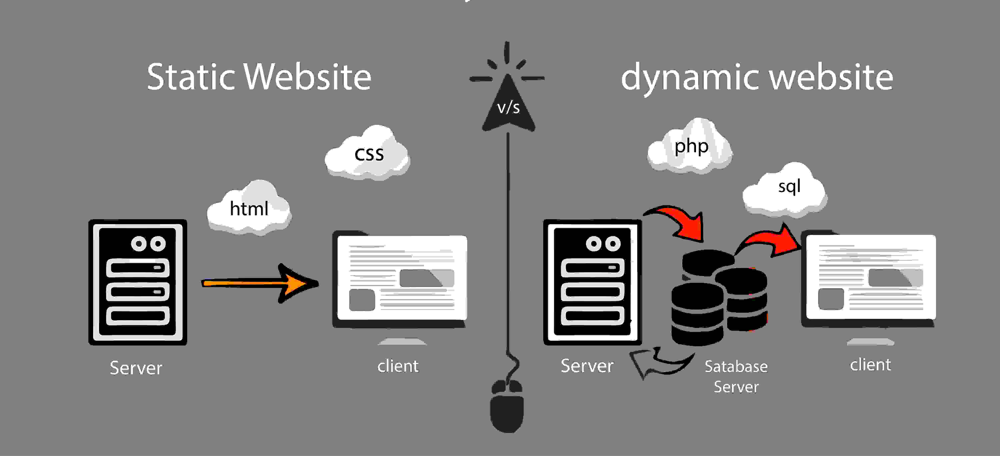
Static vs Dynamic Websites

Slide 4
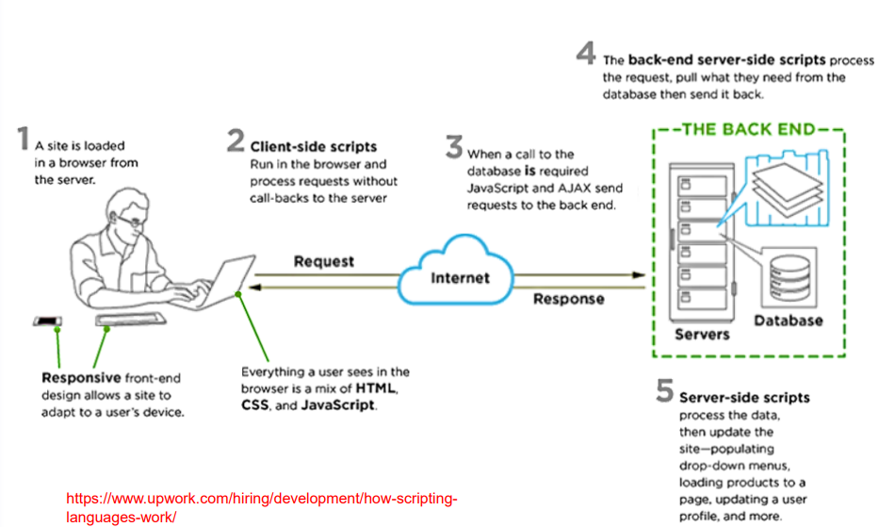
Client-Server Model
Notes:
The client is your computer, phone, or browser. It asks for information (like a webpage or a video).
The server is a powerful computer that stores and delivers the information the client asks for.
They communicate with each other (like you and the waiter) to get things done.
The client asks for something.
The server provides it.
Together, they make the internet work!

Slide 5
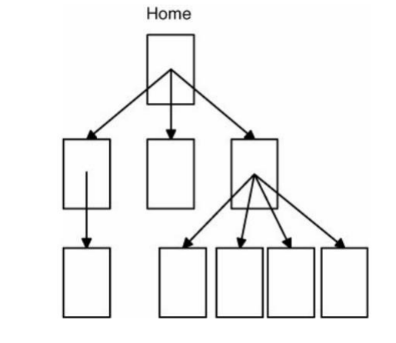
Website
Client-side technologies used to create websites.

Slide 6

Essential Technologies of WWW
Content &
Structure
Presentation
Behavior

Slide 7

HTML Hyper Text Markup Language
The standard markup language for creating web pages and web applications.
Notes:
What is HTML?
HTML is the standard markup language for creating Web pages.
HTML stands for Hyper Text Markup Language
HTML describes the structure of Web pages using markup
HTML elements are the building blocks of HTML pages
HTML elements are represented by tags
HTML tags label pieces of content such as "heading", "paragraph", "table", and so on
Browsers do not display the HTML tags, but use them to render the content of the page

Slide 8
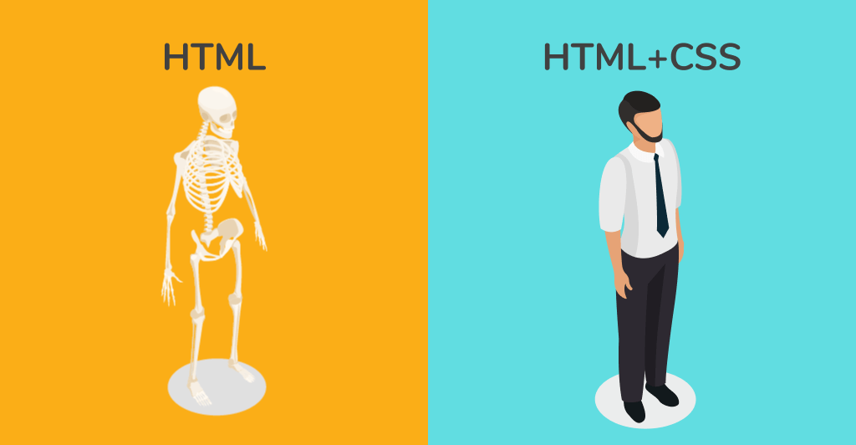
Notes:
What is HTML?
HTML is the standard markup language for creating Web pages.
HTML stands for Hyper Text Markup Language
HTML describes the structure of Web pages using markup
HTML elements are the building blocks of HTML pages
HTML elements are represented by tags
HTML tags label pieces of content such as "heading", "paragraph", "table", and so on
Browsers do not display the HTML tags, but use them to render the content of the page

Slide 9

Founder Tim Berners-Lee
Late 1991

Slide 10
Rough Timeline of Web Technologies
1991 HTML
1994 HTML 2
1996 CSS 1 + JavaScript
1997 HTML 4
1998 CSS 2
2000 XHTML 1
2002 Tableless Web Design
2005 AJAX
2006 jQuery
2009 HTML 5

Slide 11
HTML
Head
Body
HTML ANATOMY
Notes:
HTML 5
<!DOCTYPE html>
HTML 4.01 Strict
This DTD contains all HTML elements and attributes, but does NOT INCLUDE presentational or deprecated elements (like font). Framesets are not allowed.
<!DOCTYPE HTML PUBLIC "-//W3C//DTD HTML 4.01//EN" "http://www.w3.org/TR/html4/strict.dtd">
HTML 4.01 Transitional
This DTD contains all HTML elements and attributes, INCLUDING presentational and deprecated elements (like font). Framesets are not allowed.
<!DOCTYPE HTML PUBLIC "-//W3C//DTD HTML 4.01 Transitional//EN" "http://www.w3.org/TR/html4/loose.dtd">
HTML 4.01 Frameset
This DTD is equal to HTML 4.01 Transitional, but allows the use of frameset content.
<!DOCTYPE HTML PUBLIC "-//W3C//DTD HTML 4.01 Frameset//EN" "http://www.w3.org/TR/html4/frameset.dtd">
XHTML 1.0 Strict
This DTD contains all HTML elements and attributes, but does NOT INCLUDE presentational or deprecated elements (like font). Framesets are not allowed. The markup must also be written as well-formed XML.
<!DOCTYPE html PUBLIC "-//W3C//DTD XHTML 1.0 Strict//EN" "http://www.w3.org/TR/xhtml1/DTD/xhtml1-strict.dtd">
XHTML 1.0 Transitional
This DTD contains all HTML elements and attributes, INCLUDING presentational and deprecated elements (like font). Framesets are not allowed. The markup must also be written as well-formed XML.
<!DOCTYPE html PUBLIC "-//W3C//DTD XHTML 1.0 Transitional//EN" "http://www.w3.org/TR/xhtml1/DTD/xhtml1-transitional.dtd">
XHTML 1.0 Frameset
This DTD is equal to XHTML 1.0 Transitional, but allows the use of frameset content.
<!DOCTYPE html PUBLIC "-//W3C//DTD XHTML 1.0 Frameset//EN" "http://www.w3.org/TR/xhtml1/DTD/xhtml1-frameset.dtd">
XHTML 1.1
This DTD is equal to XHTML 1.0 Strict, but allows you to add modules (for example to provide ruby support for East-Asian languages).
<!DOCTYPE html PUBLIC "-//W3C//DTD XHTML 1.1//EN" "http://www.w3.org/TR/xhtml11/DTD/xhtml11.dtd">

Slide 12

<title>
<meta>
<script>
<style>
<link>
<base>
METADATA
HEAD

Slide 13
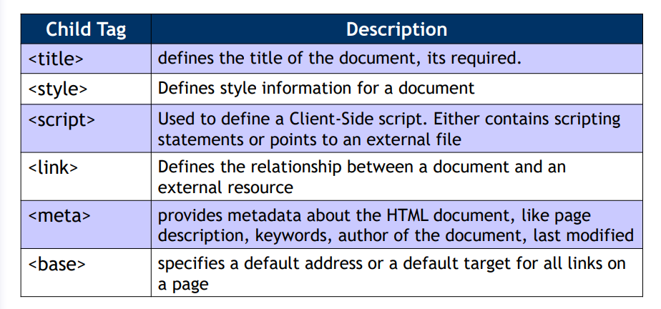
HEAD

Slide 14

Headings
Text
Lists
Links
Images
Tables
Forms
BODY
DATA
Notes:
href => Hypertext Reference
alt => alternative text

Slide 15
<
TagName
>
TAGS
DATA
</
TagName
>
SELF CLOSE
<
TagName
/>

Slide 16
TAGS ATTRIBUTES
<
TagName AttName = ‘value’
/>

Slide 17
Comments
<!-- any text -->

Slide 18
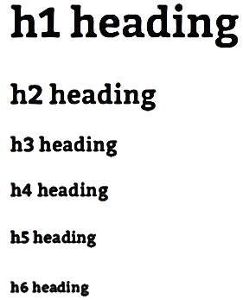
HEADING
BODY
DATA

Slide 19
TEXT
Formatting
Layout
Sizing
Whitespaces & Special Characters
Breaking Line & Separators
BODY
DATA
Notes:
Text breaking and white space
Whitespace generally ignored in block and inline
<pre> – whitespace is respected
<br /> Explicit line break
<hr /> Horizontal rule
Character entities &nbsp; - space which cannot be used for line breaks
&lt; &gt; etc. entities for HTML markup characters

Slide 20
LISTS
Unordered
Ordered
Definition
BODY
DATA
Notes:
<dl> <dt>Coffee</dt> <dd>Black hot drink</dd> <dt>Milk</dt> <dd>White cold drink</dd> </dl>

Slide 21
LINKS
File
Anchor
Email
BODY
DATA

Slide 22
IMAGES
Insert
Format
Align
BODY
DATA

Slide 23
TABLES
CAPTION
Header | Header
Body | Body
Body | Body
Footer
STRUCTURE
BODY
DATA
Notes:
<table> <caption>List Elements</caption> <thead> <tr> <th>List Type</th> <th>Tags</th> </tr> </thead> <tfoot> <tr><td>Lists can . . . </td></tr> </tfoot> <tbody>. . . </tbody> </table>

Slide 24
TABLES
DATA
Header
Merging
Row
Nested
Column
BODY
DATA

Slide 25
TABLES
FORMATING
Font
Alignment
Style
Border
Spacing
BODY
DATA
Notes:
Width / Align*
Border
Cell padding
Cell spacing
No wrap*

Slide 26
FORMS
Textbox
Password
Hidden
Checkbox
Radio button
Button
Submit
Reset
Image Button
Text Area
Dropdown List
File Loader
BODY
DATA
Notes:
<input name="myFile" type="file">

Slide 27

INLINE
TEXT
INLINE
TEXT
BLOCK
BLOCK
INLINE
TEXT
BLOCK

Slide 28

What is HTML5 ?
HTML5 is the latest evolution of the standard that defines HTML.
The term represents two different concepts. It is a new version of the language HTML, with new elements, attributes, and behaviors, and a larger set of technologies that allows the building of more diverse and powerful Web sites and applications.

Slide 29
Browser Support For HTML5
Some of the most interesting new features in HTML5
HTML5 is not yet an official standard, and no browser have full HTML5 support
But all major browsers (Chrome, Safari, Firefox, Internet Explorer, Opera) continue to add new HTML5 features to their latest versions

Slide 30
HTML5 New Elements
HTML5 includes new elements for better structure, better form handling, drawing, and for media content
New Semantic/ Structural Elements.
<article> <aside> <details> <figcaption>
<figure> <footer> <header>
<main> <mark> <nav>
<section> <summary> <time>

Slide 31
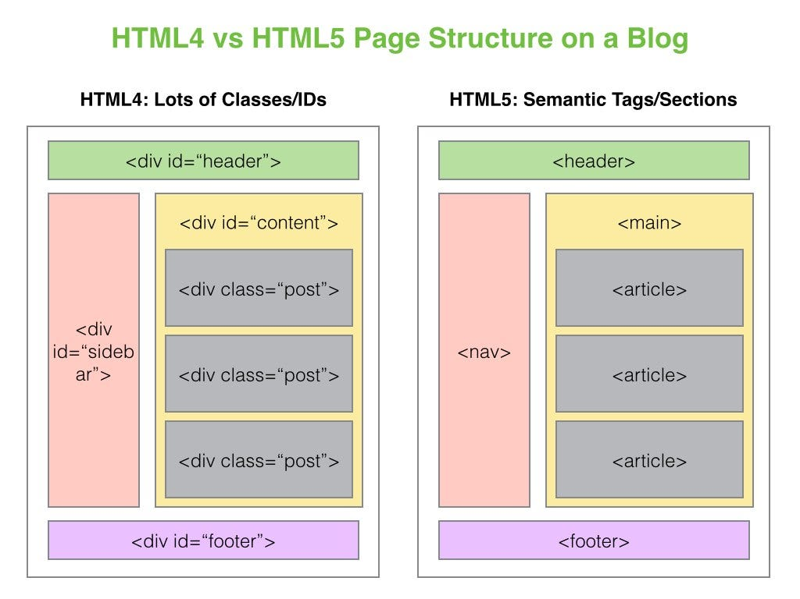

Slide 32
HTML5 FORMS
date
number
range
email
url
search
tel
color
datetime
month
week
Datetime-local
Notes:
•Input type= datetime global date-and-time input control
•input type = datetime-local local date-and-time input control
•input type = date date input control
•input type = month year-and-month input control
•input type = time time input control
•input type = week year-and-week input control
•input type = number number input control
•input type = range imprecise number-input control
•input type = email e-mail address input control
•input type = url URL input control
•input type = search search field
•input type = tel telephone-number-input field
•input type = color color-well control

Slide 33
HTML5 Forms
Input number
<input type="number" min="0" max="10" step="2" value="6” />
Input number as slider: the only difference is the user interface
<input type=“range" min="0" max="10" step="2" value="6” />

Slide 34
HTML5 Forms
Input color
<input type=“color" />
Input Date
<input type=“date" />

Slide 35
HTML5 FORMS
Attributes and functions
placeholder
required
Notes:
•Input type= datetime global date-and-time input control
•input type = datetime-local local date-and-time input control
•input type = date date input control
•input type = month year-and-month input control
•input type = time time input control
•input type = week year-and-week input control
•input type = number number input control
•input type = range imprecise number-input control
•input type = email e-mail address input control
•input type = url URL input control
•input type = search search field
•input type = tel telephone-number-input field
•input type = color color-well control

Slide 36



REFERENCES

Slide 37
Questions ???

